Slide 1
Regular Languages and Closure + Decision Properties
Chapter 9-11

Slide 2
Regular Languages
A language that can be defined by a regular expression is called a regular language.
1. Closure Properties
2. Decision Properties
The language that cannot be defined by a regular expression are nonregular languages e.g. PALINDROME, PRIME

Slide 3
Closure Properties of Regular Languages
If certain languages are regular, and a language L is formed from the application of some special operations, then L is also regular.
Principal Closure Properties
  Union of two regular languages is regular
  Complement of a regular language is regular
  Intersection of two regular languages is regular
  Closure of a regular language is regular
  Product / Concatenation of regular languages is regular

Slide 4
Closure Properties of Regular Languages (Union)
If L and M are regular languages over alphabet ∑ then L U M is the language that contains all strings that are in either or both of L and M.
“Union of Two regular languages is regular” i.e. Set of Regular Languages is Closed under Union.

Slide 5
Closure Properties of Regular Languages (Union)
Proof (By Regular Expression)
If L1 and L2 are regular languages, there are regular expressions r1 and r2 that define these languages. Then (r1+r2) is a regular expression that defines the language L1+L2. Hence L1+L2 (L1 U L2) is a regular language.

Slide 6
Closure Properties of Regular Languages (Union)
Proof by Machines
-
Λ
Λ
-
-
TG1
TG2
+
+

Slide 7
Another Method
Example
We will consider two FA’s
Then Construct the FA for the Union of These FA’s

Slide 8
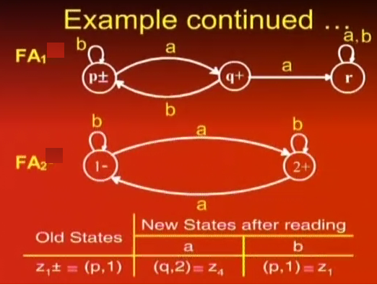

Slide 9
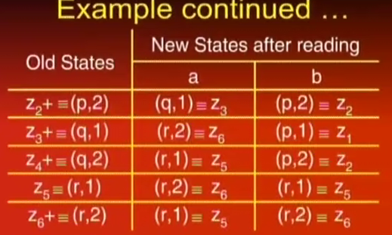

Slide 10
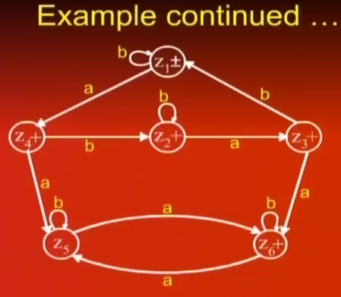

Slide 11
Closure Properties of Regular Languages (Complement)
If L is a language over the alphabet ∑, then its complement denoted by L^{C} is a language consisting of all strings from ∑* that are not words in L.
If L is a regular Language, then L^{C} is also a regular language. i.e. the set of regular languages is closed under complementation

Slide 12
Closure Properties of Regular Languages (Complement)
Proof
  If L is a regular language then Kleen’s Theorem states that there is some FA that accepts the language L.
  This FA contains some final states. Reverse the final status of each state.
  This new FA will now accept all the strings that were previously being rejected and reject all the previously accepted strings i.e. it accepts the words of L^{C}.
  Thus this new FA defines L^{C} which by Kleen’s theorem indicates that L^{C} can also be defined by a Regular Expression and hence is a Regular language

Slide 13
Closure Properties of Regular Languages (Complement)
Example
a
b
a,b
a
b
a,b
-
+
-
+
+
+
a
a
b
b
a,b
a,b
+
a,b
a,b

Slide 14
Closure Properties of Regular Languages (Intersection)
Let L and M be languages over alphabet ∑. Then L ∩ M is the language that contains all strings that are in both L and M
Intersection of Regular Languages
  If L1 and L2 are regular languages then L1 ∩ L2 is also a regular language. i.e. Set of regular languages is closed under intersection

Slide 15
Closure Properties of Regular Languages (Intersection)
Proof
By Demorgan’s Law
L1 ∩ L2 = (L1’ U L2’)’
        = (L1’ + L2’)’
This implies that L1 ∩ L2 consists of all words that are not in either L1^{C} or L2^{C}. As L1 and L2 are regular languages so are L1^{C} and L2^{C}. There union L1^{C} + L2^{C} is also a regular language.

Slide 16
Closure Properties of Regular Languages (Intersection)
L1 = all strings with a double a
L2 = all strings with an even number of a’s
Both are regular languages and they have following RE respectively
R1 = (a+b)*aa(a+b)*
R2 = b*(ab*ab*)*
Both languages are regular, Kleen’s Theorem says that they can also be defined by FAs
a
a,b
b
a
b
b
a
-
+
-
+
b
FA1
a
FA2

Slide 17
Closure Properties of Regular Languages (Intersection)
Complements of FAs
a
a,b
b
a
b
b
a
x1-
+
+
x3
y1-
y2+
b
FA1’
a
FA2’
Join the machines to get FA3 = FA1^{C} + FA2^{C} which defines the language (L1^{C} + L2^{C})
Reverse the final status of each state of FA3 to get (FA1^{C}+FA2^{C})^{C} that defines L1 ∩ L2
Apply the TG to RE conversion (of Kleen’s Theorem) over FA3 to get r3 that defines the intersection of both languages

Slide 18
Closure Properties of Regular Languages (Intersection)
Second Method of Intersection
a
a,b
b
a
b
b
a
x1-
x2
x3+
y1-
+
y2
b
FA1
a
FA2
Join both the machines to get FA3 = FA1+FA2 that defines L1+L2
FA3 consists of states of both FA1 and FA2. Remove all the + and put a + only at a state where the corresponding x and y components both are final

Slide 19
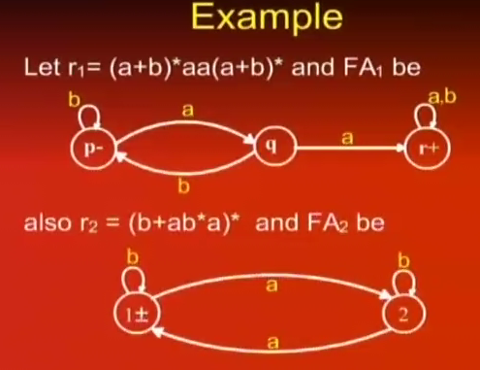

Slide 20
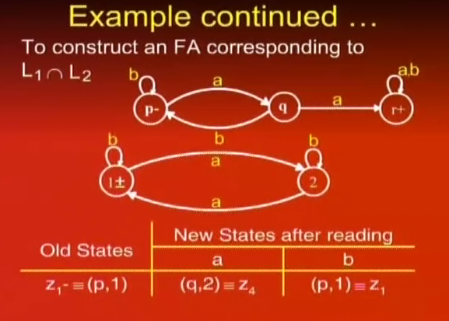

Slide 21
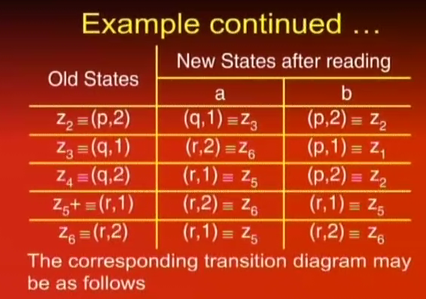

Slide 22
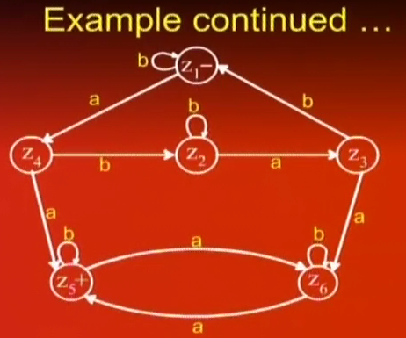

Slide 23
Closure Properties of Regular Languages (Closure)
If L is a regular expression then L* consists of all strings formed by the concatenation of arbitrarily many factors of L
Closure Property
  If L is a regular language so is L*

Slide 24
Closure Properties of Regular Languages (Closure)
Proof (By regular expression)
If a regular lanugage L is defined by a regular expression r then the language L* can be defined by r*. Thus L* is a regular language

Slide 25
Closure Properties of Regular Languages (Closure)
Proof (By Machines)
-
Λ
TG1
Λ
+

Slide 26
Closure Properties of Regular Languages (Concatenation)
If L1 and L2 are two regular languages then L1L2 contains all words formed by concatenation of a word from L1 with a word from L2
Concatenation of Regular Languages
  If L1 and L2 are two regular languages then so is L1L2 (i.e. their concatenated form)

Slide 27
Closure Properties of Regular Languages (Concatenation/Product)
Proof (By Regular Expression)
If L1 and L2 are regular languages then there are two regular expressions r1 and r2 which define these respectively. The language L1L2 can be defined by r1r2 which is also a regular expression. Hence L1L2 is also a regular language.

Slide 28
Closure Properties of Regular Languages (Concatenation/Product)
Proof (By Machines)
Λ
-
1
2
+
TG1
TG2

Slide 29
Non regular Languages
A language that cannot be defined by a regular expression
L={^,ab,aabb,aaabbb,aaaabbbb,aaaaabbbbb,…}
L = {a^{n}b^{n} for n=0 1 2 3 4 5 …}
Or L = {a^{n}b^{n}}
L is a non regular language as it can not be defined by any RE

Slide 30
Pumping Lemma
Regular languages are defined by Regular expressions and accepted by DFA, NFA and TG.
Non regular languages need some powerful machines for their description
The pumping lemma is used to prove that certain languages are non-Regular

Slide 31
Pumping Lemma
Two types of languages
  Finite & infinite languages
Finite Language is always regular
Infinite Language may be regular or non-regular
Pumping Lemma is one of the methods to find out language is non-Regular
Pumping Lemma performs negative-test?

Slide 32
Pumping Lemma
Pumping Lemma performs negative-test
  If we apply Pumping Lemma on a language and the language passes that test (+ve), then there is still no certainty that the language is regular or non-regular (i.e. it’s undecidable)
    Note: A decidable language, in computer science, is a language for which there exists some algorithm that can determine, in a finite amount of time, whether a given string belongs to the language or not.
  But if the language fails the Pumping Lemma test, then
  it is sure that the language is
  non-regular.

Slide 33
Pumping Lemma
“Let L be any regular language that has infinitely many words. Then there exist some three strings x, y and z (where y is not null) such that all the strings of the form xy^{n}z for n =1,2 ,… are words in L”

Slide 34
Pumping Lemma
Proof
If L is a regular Language then there is an FA that accepts exactly the words in L.
Let w be some word in L that has more letters in it than there are states in the FA.
When this string is executed on FA , the path it traces cannot visit a new state for each letter of the string because there are more letters than states.
Therefore, it must at some point revisit a state that has already been visited.

Slide 35
Pumping Lemma
The word w can be broken into three parts
  X: Consisting of all letters of w starting at the beginning that lead up to the first state that is revisited. X can be null if the path for w revisits the start state as its first revisit
  Y: It starts at the letter after the substring x. It denotes the substring of w that travels around the circuit coming back to the same state the circuit began with. Because there must be a circuit hence y cannot be null even if it loops around just once
  Z: This is the rest of the string of w after substring y. It can be null. It may also loop around the y-circuit or any other

Slide 36
Pumping Lemma
Thus w = xyz and w is accepted by this machine
Path for xyyz

Slide 37
Pumping Lemma
Example
a
b
b
1-
2+
3
a
a
b
b
a
a,b
4
5
a
6+
b
W = bbbababa, bbbabbababa

Slide 38
Pumping Lemma
Application
Let L = {a^{n}b^{n} for n=0,1,2,3, ….}
Breakdown into three components xyz
Y as sequence of a’s (xyyz)
Y as all b’s (xyyz)
Y as combination of a’s and b’s (xyyz)
Is L Regular?

Slide 39
Pumping Lemma (Version 2)
If L is an infinite language accepted by an FA with N states. Then for all words w in L that have more than N letters, there are string x, y and z where y is not null and length(x)+length(y) does not exceed N such that w = xyz and all string of the form xy^{n}z are in L
Application on PRIME

Slide 40
Decidability of Regular Languages
Decidability is concerned with three issues
  Is the language described empty (Emptiness)
  Do two descriptions of a language actually describe the same language (Equivalence)
  Language defined by an FA has finitely or infinitely many words in it (Finiteness)

Slide 41
Decidability of Regular Languages (Emptiness)
Checking Emptiness (Formal Method through FA)
  Paint the start state blue
  From every blue state, follow edge that leads out of it and paint the destination state blue, then delete this edge from the machine
  Repeat above step until no new state is painted blue
  When the procedure has stopped , if any of the final states are painted blue, then the machine accepts some words and if not it does not

Slide 42
Decidability of Regular Languages (Emptiness and Non Emptiness)
whether a finite automata accept anything or not?
if a FA accepts even a single string we say it's non-empty else it is empty
Step-1: select the state that cannot be reached from the initial states and delete them (meaning that remove unreachable states)
Step-2: if the resulting machine contains at least one final state so then the FA accepts the non-empty language
Step-3: if the resulting machine is free from final state then the FA accepts empty language

Slide 43
Decidability of Regular Languages (Equivalence)
Checking Equivalence of Regular languages
  Given two regular languages L₁ and L₂ defined by either of RE or FA
  Build FA for L₁’ and L₂’
  Create FAs for L₁ ∩ L₂’ and L₂ ∩ L₁’
  Build automaton for (L₁ ∩ L₂’)+(L₂ ∩ L₁’)
  This machine accepts the language of all words that are in L₁ but not in L₂ or else in L₂ but not in L₁.
  If L₁ and L₂ are the same language, this machine cannot accept any words. If this machine accepts a single word (even the Λ) then L₁ is not equal to L₂.

Slide 44
Decidability of Regular Languages (Equivalence)
Equivalence
a,b
a
a,b
a
p1+-
b
p2
q1-
b
q2+
FA1
FA1’
a,b
a,b
r1+-
b
r2
s1-
b
s2+
a
a
a
b
a
b
r3+
s3+
FA2
FA2’

Slide 45
Decidability of Regular Languages (Equivalence)
Equivalence of Regular Languages
  (L₁ ∩ L₂’) + (L₂ ∩ L₁’) = (L₁’ + L₂)’ + (L₂’ + L₁)’
p1 or s3
q1 or r1
p1 or s1
q1 or r3
a
a
-
a
-
a
a,b
a,b
b
b
b
b
p2 or s2
q2 or r2
(FA1’+FA2)’
(FA2’+FA1)’

Slide 46
Decidability of Regular Languages (Finiteness)
Finiteness (through Regular Expressions)
  Scan the RE and if it contains the closure operator “*” then the RE defines an infinite language
  What about
  Λ*, (Λ+aΛ*)(Λ*+Λ)* and (Λ+aΛ)*(Λ*+Λ)*
  Only the second defines infinite language
  If language is being defined by an FA then it can be converted into an RE and verified for finiteness

Slide 47
Decidability of Regular Languages (Finiteness & Infinitness)
If we have a FA and we want to know whether any language accepted by it is finite or not?
Step-1: select the state that cannot be reached from the initial states and delete them (meaning that remove unreachable states)
Step-2: select a state from which we cannot reach the final state and delete them (which means remove dead states)
Step-3: if the resulting machine contains any loops or cycles then the FA accepts infinite language
Step-4: if the resulting machine do not contain any loops or cycles then the FA accepts finite language

